Slide 1
Introduction
Pathfinding is the process of finding a path between two points
Unity has a built-in NavMesh system, but there are also other pathfinding libraries and assets available
In this presentation, we'll explore some of these alternative pathfinding methods

Slide 2
Introduction
Pathfinding is the process of finding a path between two points
Unity has a built-in NavMesh system, but there are also other pathfinding libraries and assets available
In this presentation, we'll explore some of these alternative pathfinding methods

Slide 3
3 Main Types of Pathfinding algorithm
Navigation Mesh
Recast Navigation
Pathfinding is the process of finding a path between two points
Unity has a built-in NavMesh system, but there are also other pathfinding libraries and assets available
In this presentation, we'll explore some of these alternative pathfinding methods
A* Pathfinding

Slide 4
Introduction
3 Main Types of Pathfinding algorithm
Navigation Mesh
A* Pathfinding
Recast Navigation
Pathfinding is the process of finding a path between two points
Unity has a built-in NavMesh system, but there are also other pathfinding libraries and assets available
In this presentation, we'll explore some of these alternative pathfinding methods

Slide 5
Navigation Mesh
Navigation Mesh (NavMesh) is a built-in pathfinding system in Unity
It works by generating a mesh that represents the walkable surfaces in the scene
Agents can then navigate the mesh to find a path between two points
Advantages: efficient, easy to use
Disadvantages: can be limited in complex environments, requires level design to create the mesh
A* Pathfinding
Recast Navigation

Slide 6
Introduction
3 Main Types of Pathfinding algorithm
Navigation Mesh
A* Pathfinding
Recast Navigation
Pathfinding is the process of finding a path between two points
Unity has a built-in NavMesh system, but there are also other pathfinding libraries and assets available
In this presentation, we'll explore some of these alternative pathfinding methods

Slide 7
Introduction
A* Pathfinding
Recast Navigation
Navigation Mesh
A* is a popular pathfinding algorithm used in many games and applications
It works by expanding a search tree of possible paths, selecting the path with the lowest cost
Cost is determined by a combination of distance to the goal and other factors, such as terrain difficulty or enemy presence
Advantages: flexible, can handle complex environments and obstacles
Disadvantages: can be slow for large maps, requires careful tuning of heuristics

Slide 8
Introduction
3 Main Types of Pathfinding algorithm
Navigation Mesh
A* Pathfinding
Recast Navigation
Pathfinding is the process of finding a path between two points
Unity has a built-in NavMesh system, but there are also other pathfinding libraries and assets available
In this presentation, we'll explore some of these alternative pathfinding methods

Slide 9
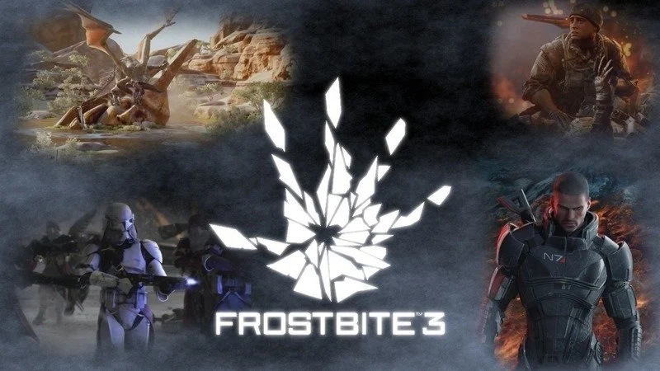
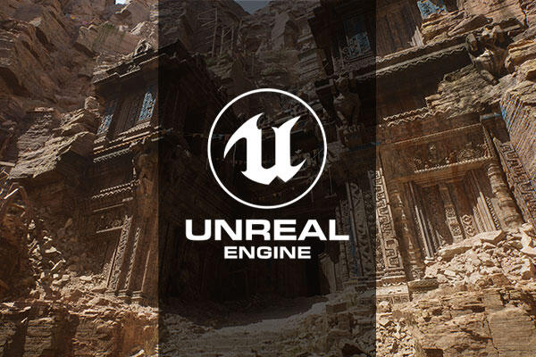
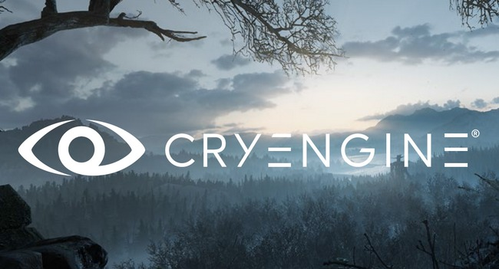
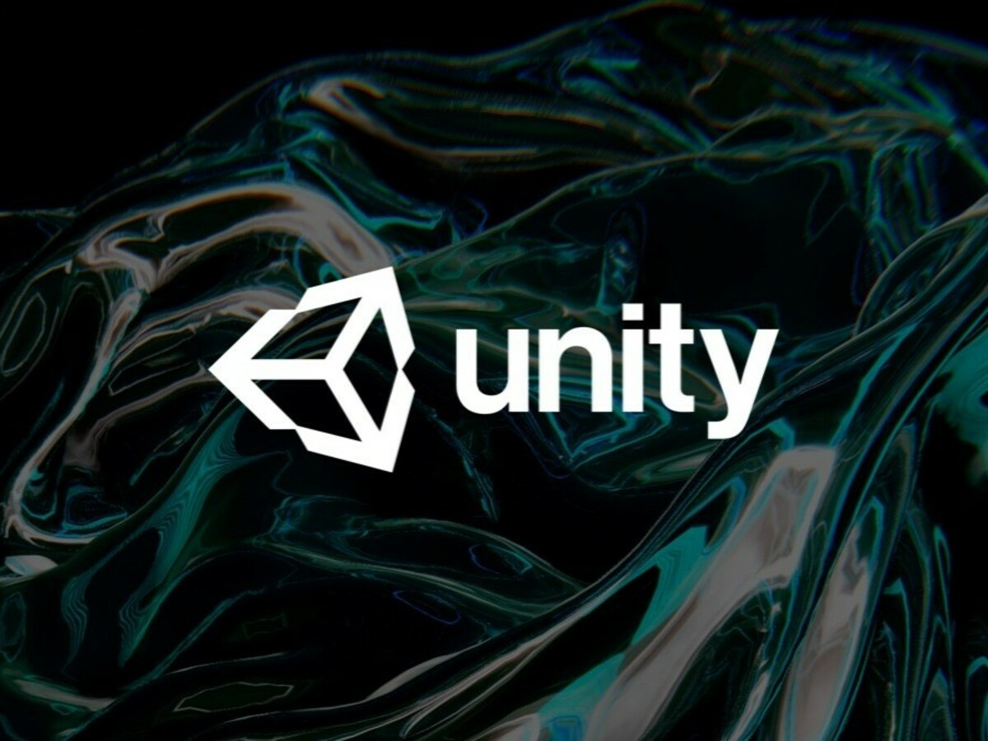
A* Pathfinding
Introduction
Recast Navigation
Recast Navigation is a pathfinding library developed by Mikko Mononen
It works by generating a navigation mesh similar to Unity's NavMesh, but with more advanced features
Agents can then navigate the mesh using A* or other algorithms
Advantages: more flexible and powerful than NavMesh, can handle dynamic obstacles and complex terrains
Disadvantages: can be more complex to set up and use, may require more memory and processing power
Navigation Mesh

Slide 10
A* Pathfinding
Comparison Across Game Engines
Recast Navigation
Navigation Mesh
Different game engines use different pathfinding methods, depending on their strengths and limitations
Unreal Engine uses its own pathfinding system called NavMesh, similar to Unity's
CryEngine uses a navigation system called Flow Graph, which allows designers to create custom pathfinding logic
Frostbite Engine uses a system called Navigation Mesh, which is similar to NavMesh but with additional features for multiplayer and procedural generation
Recast Navigation is a pathfinding library developed by Mikko Mononen
It works by generating a navigation mesh similar to Unity's NavMesh, but with more advanced features
Agents can then navigate the mesh using A* or other algorithms
Advantages: more flexible and powerful than NavMesh, can handle dynamic obstacles and complex terrains
Disadvantages: can be more complex to set up and use, may require more memory and processing power

Slide 11
A* Pathfinding
Comparison Across Game Engines
Recast Navigation
Navigation Mesh
Different game engines use different pathfinding methods, depending on their strengths and limitations
Unreal Engine uses its own pathfinding system called NavMesh, similar to Unity's
CryEngine uses a navigation system called Flow Graph, which allows designers to create custom pathfinding logic
Frostbite Engine uses a system called Navigation Mesh, which is similar to NavMesh but with additional features for multiplayer and procedural generation
Recast Navigation is a pathfinding library developed by Mikko Mononen
It works by generating a navigation mesh similar to Unity's NavMesh, but with more advanced features
Agents can then navigate the mesh using A* or other algorithms
Advantages: more flexible and powerful than NavMesh, can handle dynamic obstacles and complex terrains
Disadvantages: can be more complex to set up and use, may require more memory and processing power

Slide 12
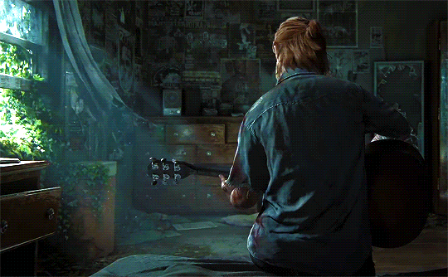
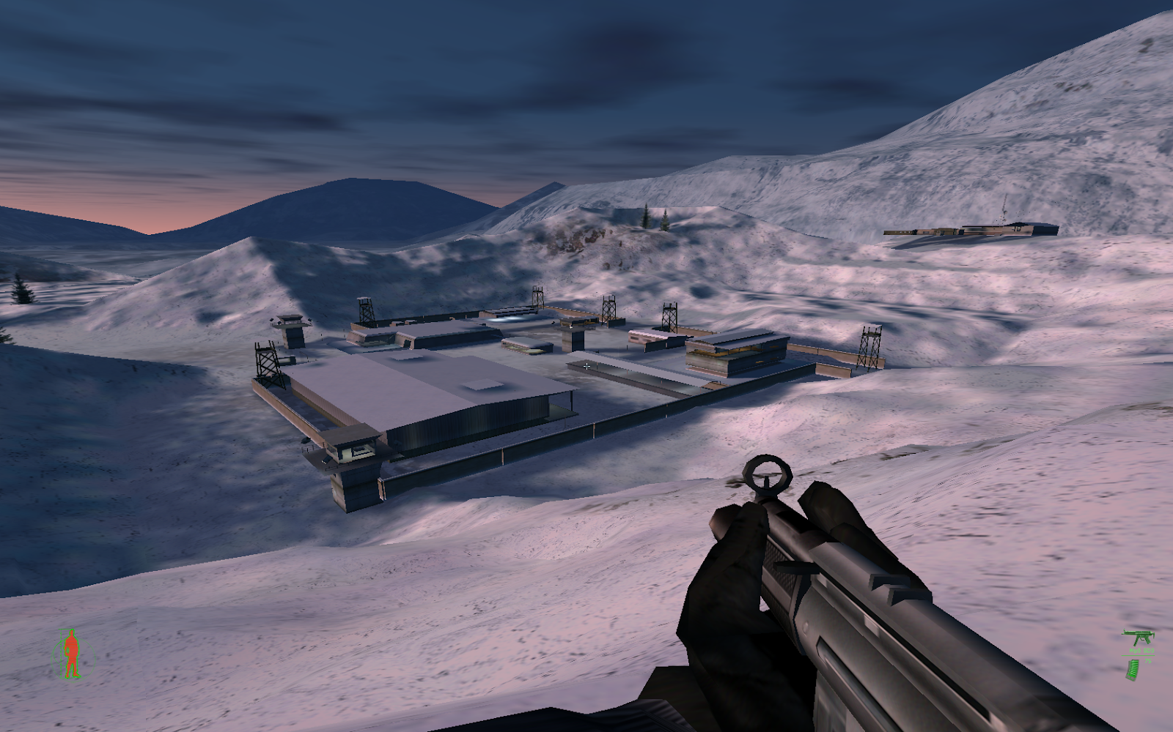
Favorite Video Games
The Last of Us
Project IGI
"The Last of Us" series by Naughty Dog uses a combination of A* pathfinding and NavMesh for its enemy AI
Enemies use A* to navigate the environment and find the player, while the NavMesh is used for player movement and cover systems

Slide 13
The Last of Us
"The Last of Us" series by Naughty Dog uses a combination of A* pathfinding and NavMesh for its enemy AI
Enemies use A* to navigate the environment and find the player, while the NavMesh is used for player movement and cover systems
Project IGI

Slide 14
Project IGI
"Project IGI" series by Innerloop Studio uses a custom pathfinding system that calculates a potential field based on the player's goals and obstacles in the environment
The system then guides the player towards the goal while avoiding obstacles, with additional logic for sneaking and stealth gameplay

Slide 15
Conclusion
There are many different pathfinding methods and systems available for game developers to choose from
The best choice depends on the specific needs of the game and the environment it takes place in
By understanding the strengths and weaknesses of different pathfinding methods, developers can create more efficient and effective navigation systems for their games.

